Slide 1
Fattori che limitano la produzione primaria terrestre
Temperatura
Precipitazioni
Luce
Nutrienti

Slide 2
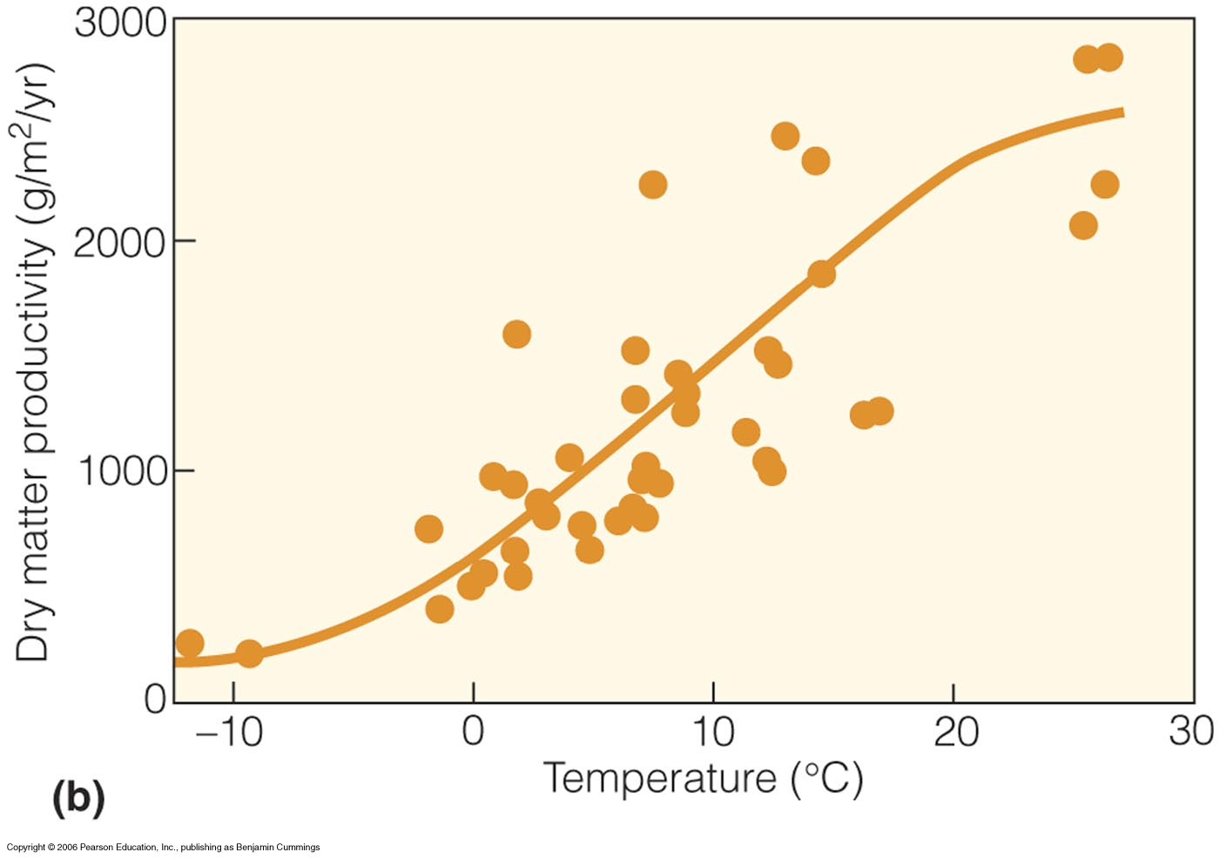
Fattori di controllo in ecosistemi terrestri
Notes:
A variety of environmental factors (climate, radiation) influence productivity
Mean annual temperature: higher temp also means longer growing season - both higher rates and more days over which there is photosynthesis

Slide 3
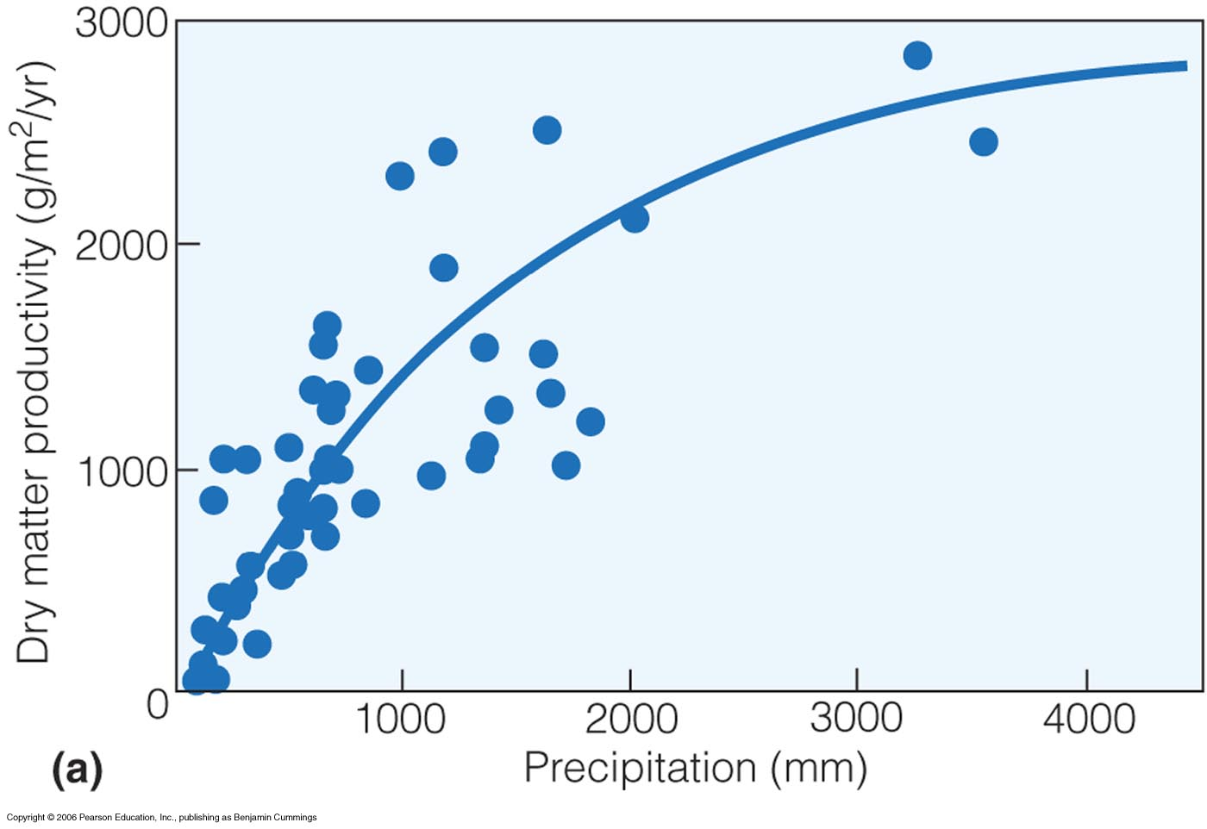
Fattori di controllo in ecosistemi terrestri
Notes:
The higher the rainfall more water available for transpiration, stoma can remain open and photosynthesis can take place for longer than if drier.
Interaction of temperature and moisture; warmer temperature increase evapotranspiration, there increase water demand if not enough water, productivity will be low [explains variability in previous slide]
Need both high temperature and high moisture for highest production

Slide 4
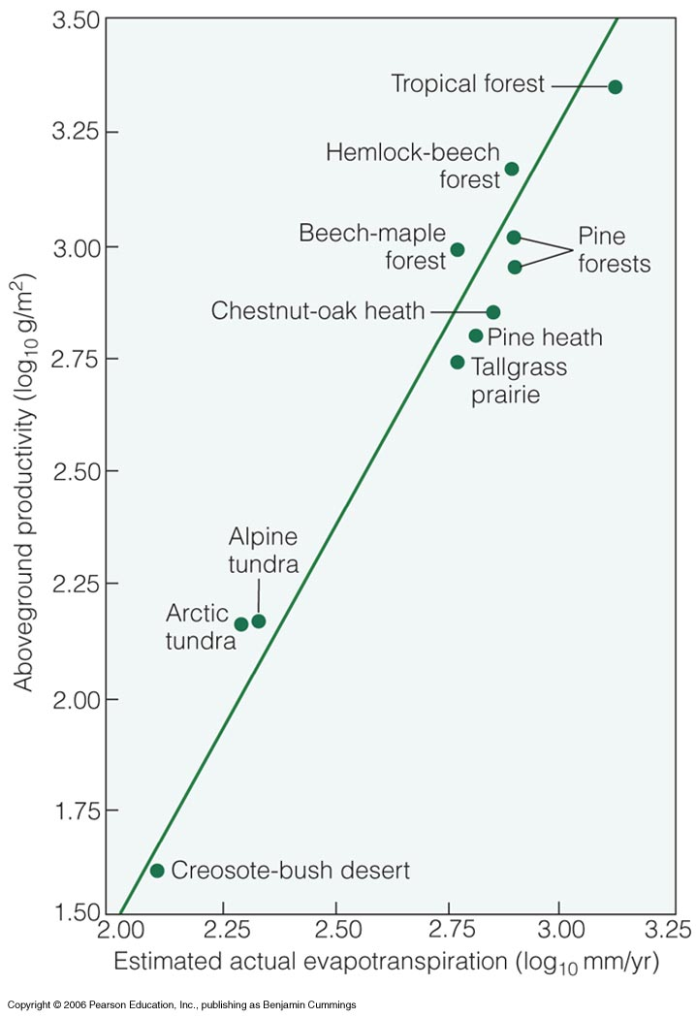
Fattori di controllo in ecosistemi terrestri
Notes:
Figure 20.4
AET is combined value of surface evaporation and transpiration - it reflects both the demand and the supply of water to the ecosystem; demand is determined by temperature and solar radiation, whereas supply is a function of precipitation…

Slide 5
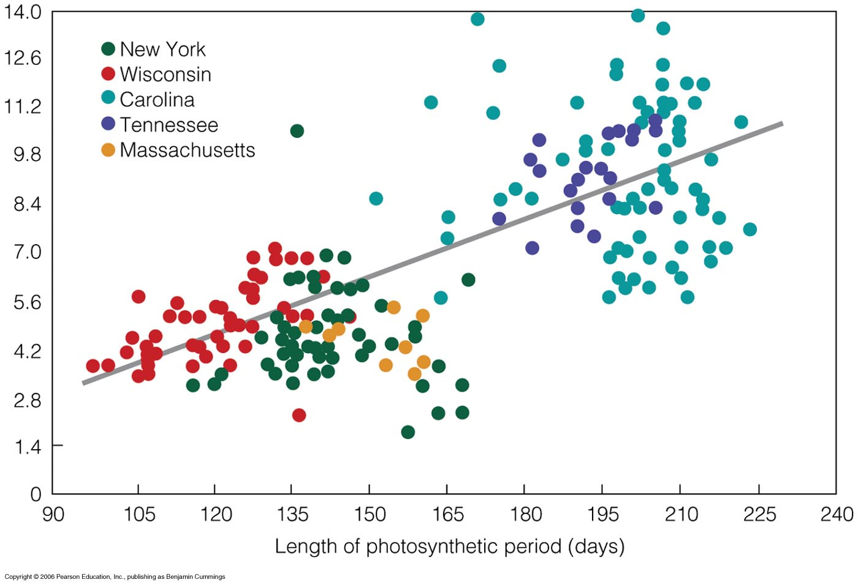
Fattori di controllo in ecosistemi terrestri
Notes:
Figure 20.3
Higher temperature correspond to longer photosynthetic periods..

Slide 6
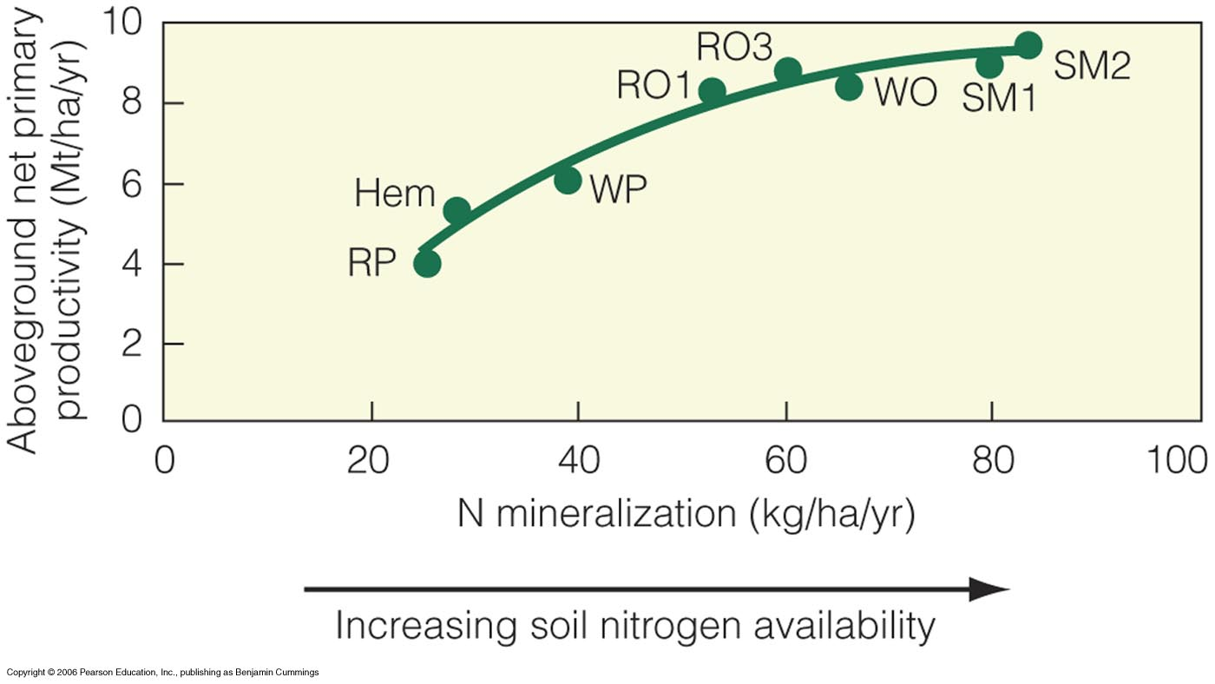
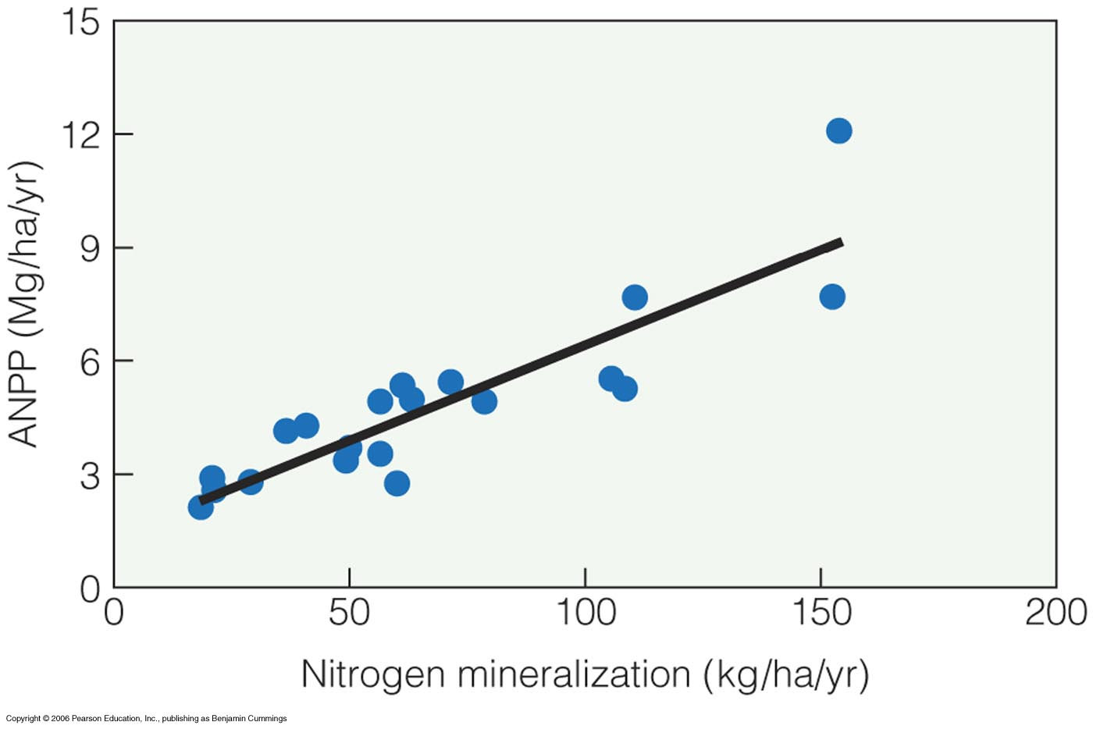
Fattori di controllo in ecosistemi terrestri
Notes:
In addition to climate, the availability of essential nutrients required for plant growth has a direct effect on ecosystem productivity.
John Pastor, Uof Min on Blackhawk Island, Wisconsin, clearly show relationship between nitrogen avaiability and aboveground primary productivity

Slide 7
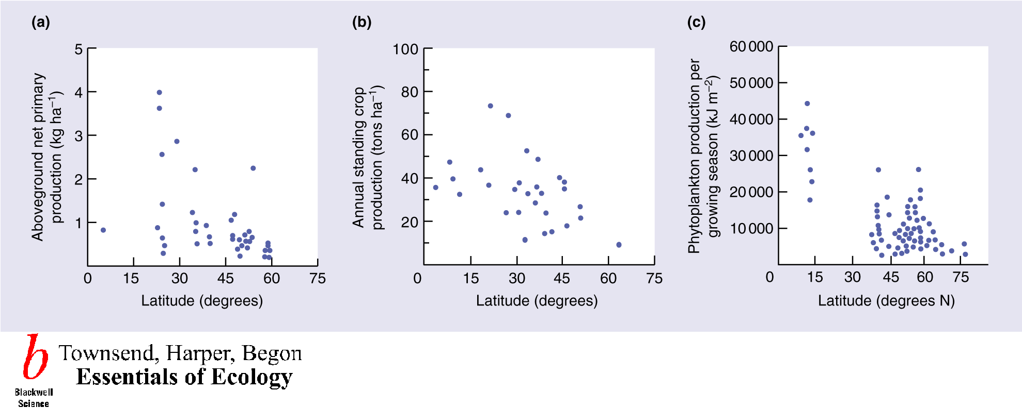
La latitudine come fattore di controllo
Il trend è ovunque decrescente: a) prateria e tundra; b) Campi coltivati; c) Laghi

Slide 8
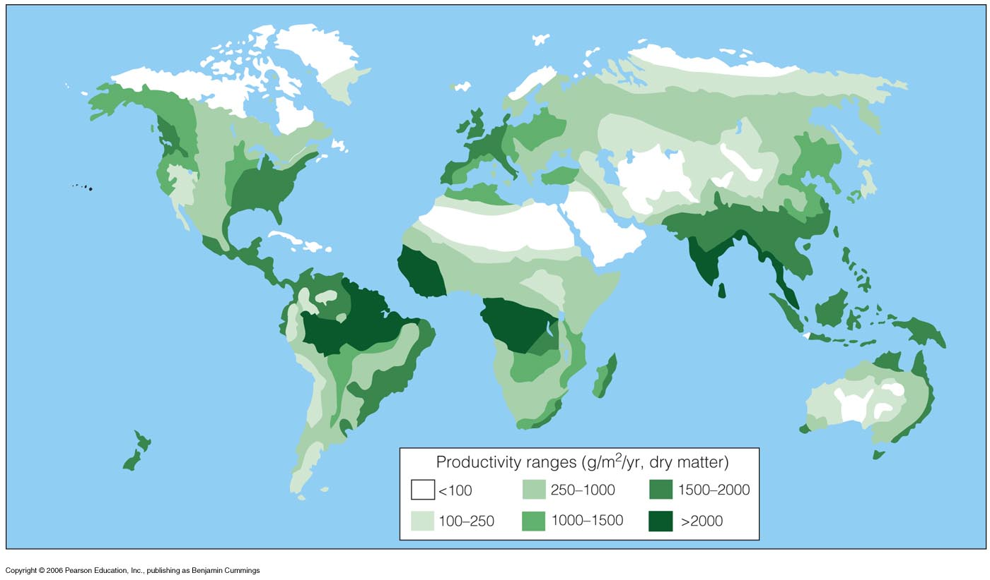
Mappa globale di produttività primaria
Notes:
Figure 20.5
Highest productivity near equator (high temp, lots of precip), lower away from equator, first because of lower precip, second because of lower temp.

Slide 9
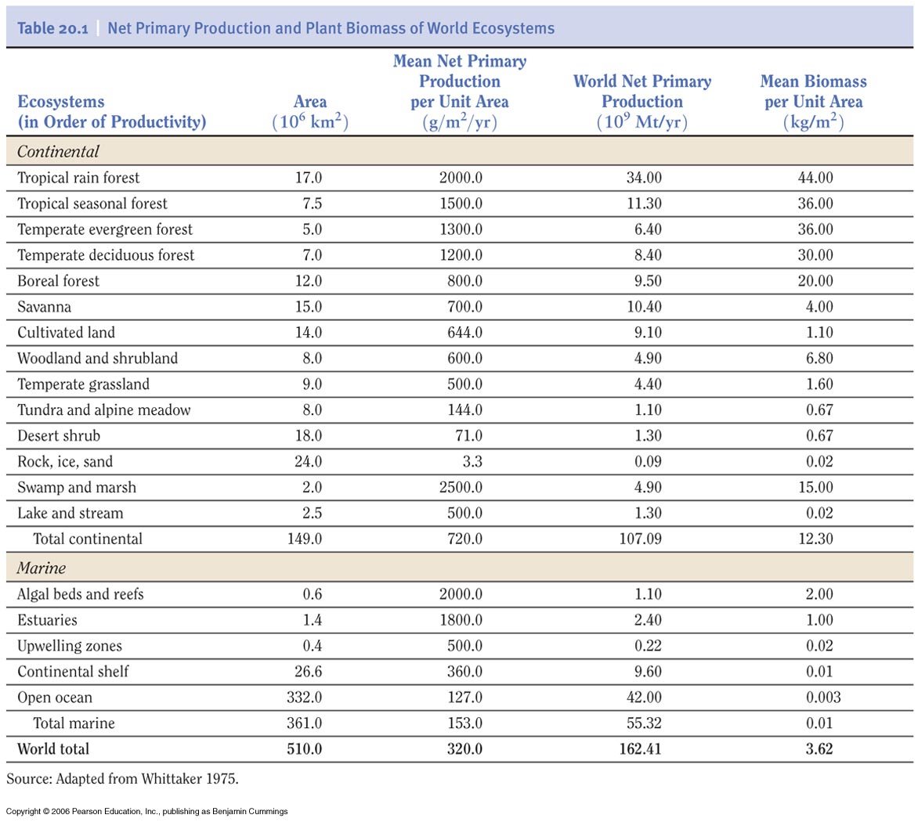

Slide 10
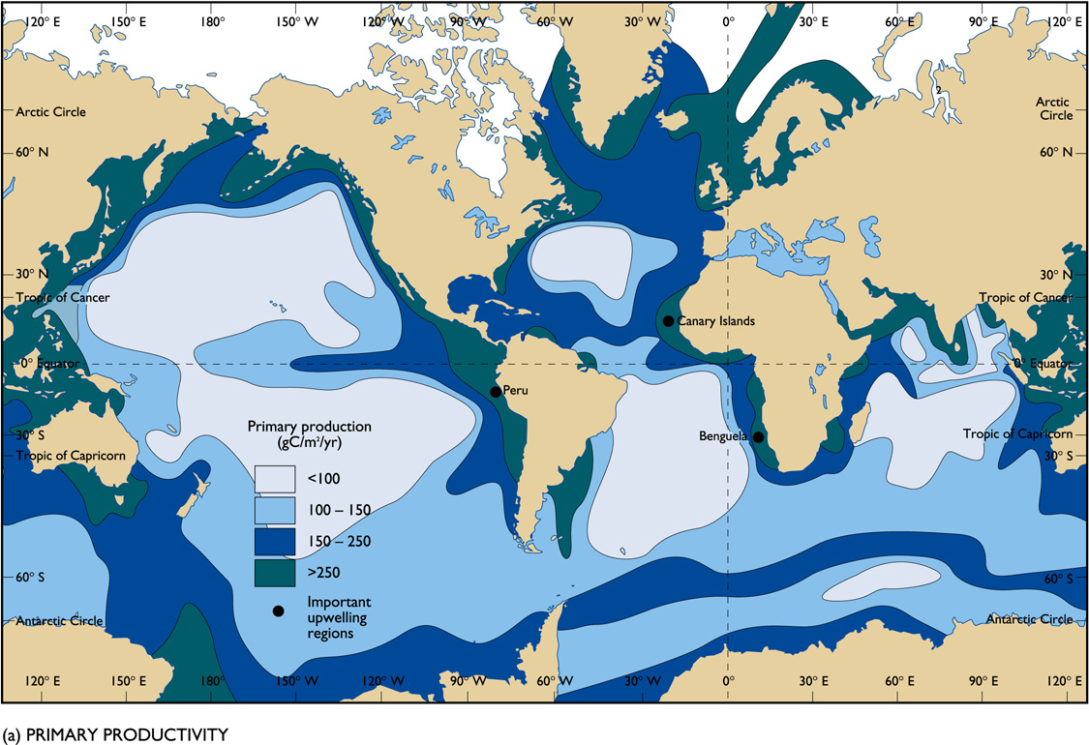

Slide 11
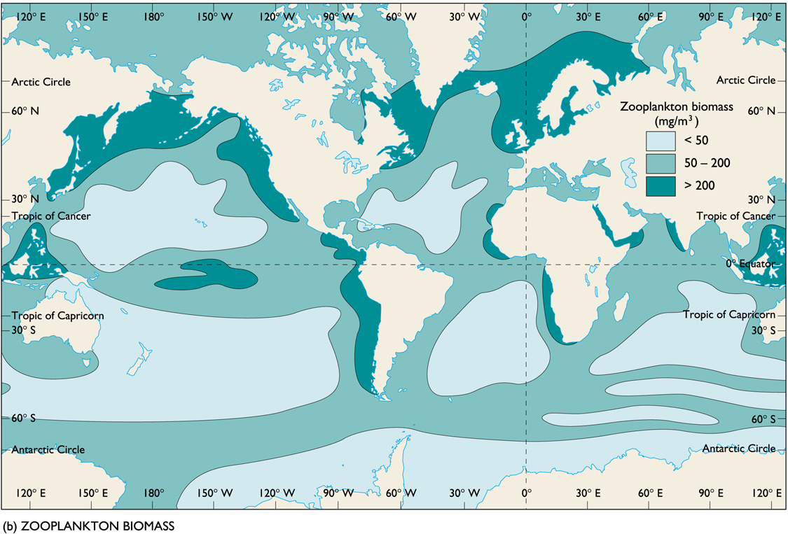

Slide 12
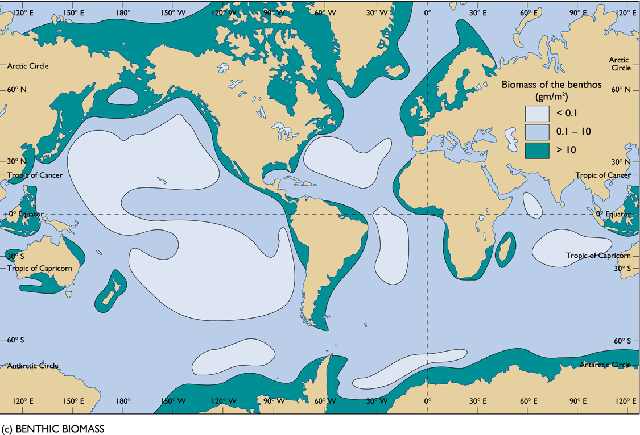

Slide 13
Fattori che limitano la produzione primaria aquatica
Temperatura
Precipitazioni
Luce
Nutrienti

Slide 14
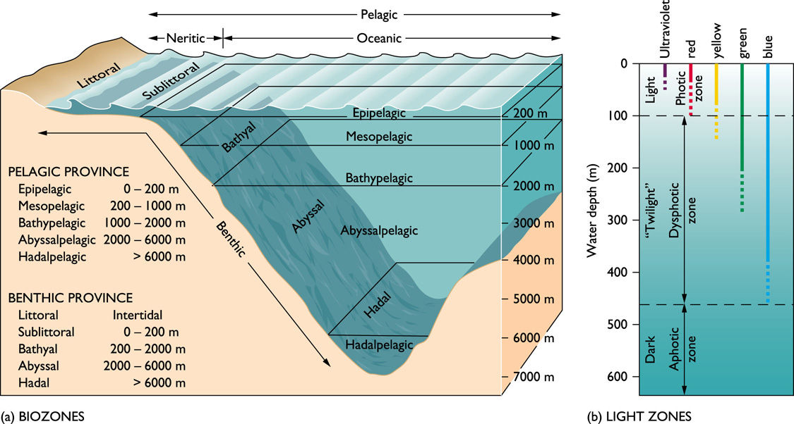

Slide 15
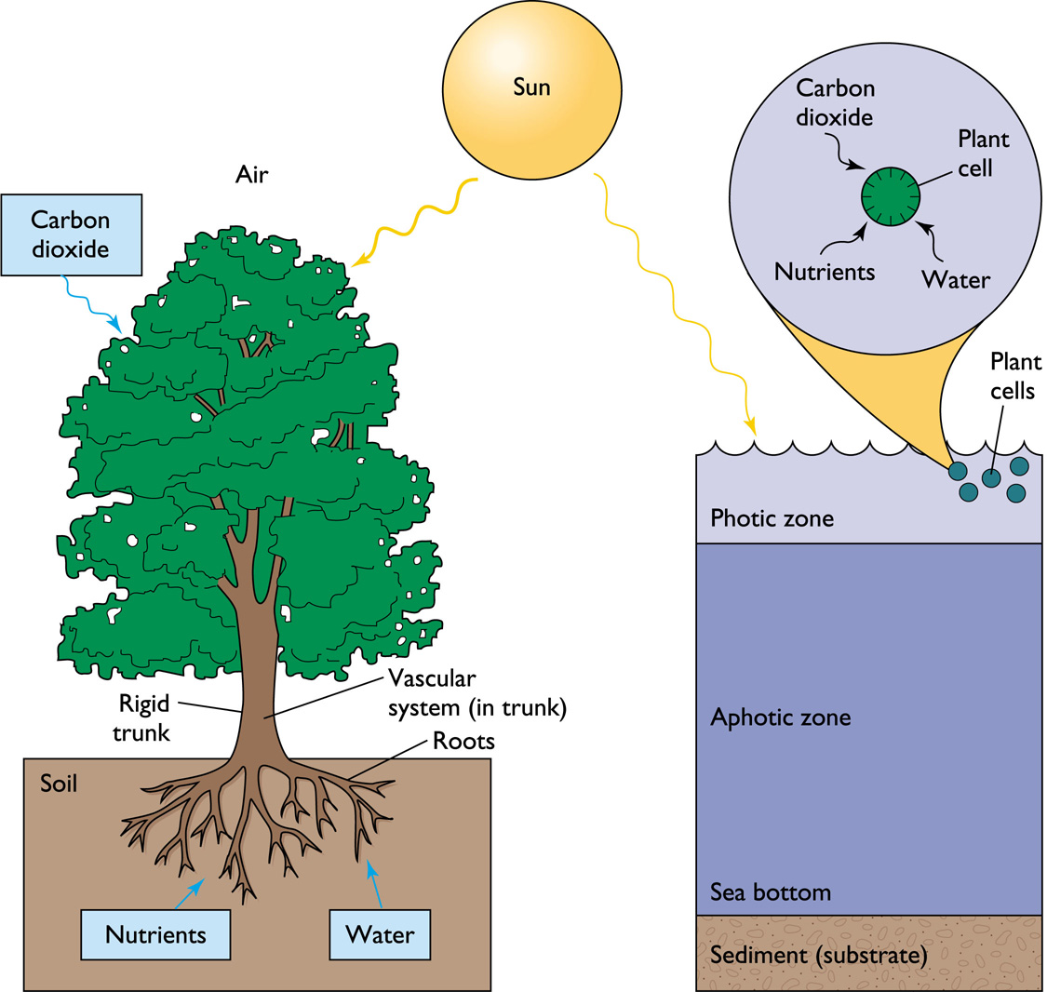

Slide 16
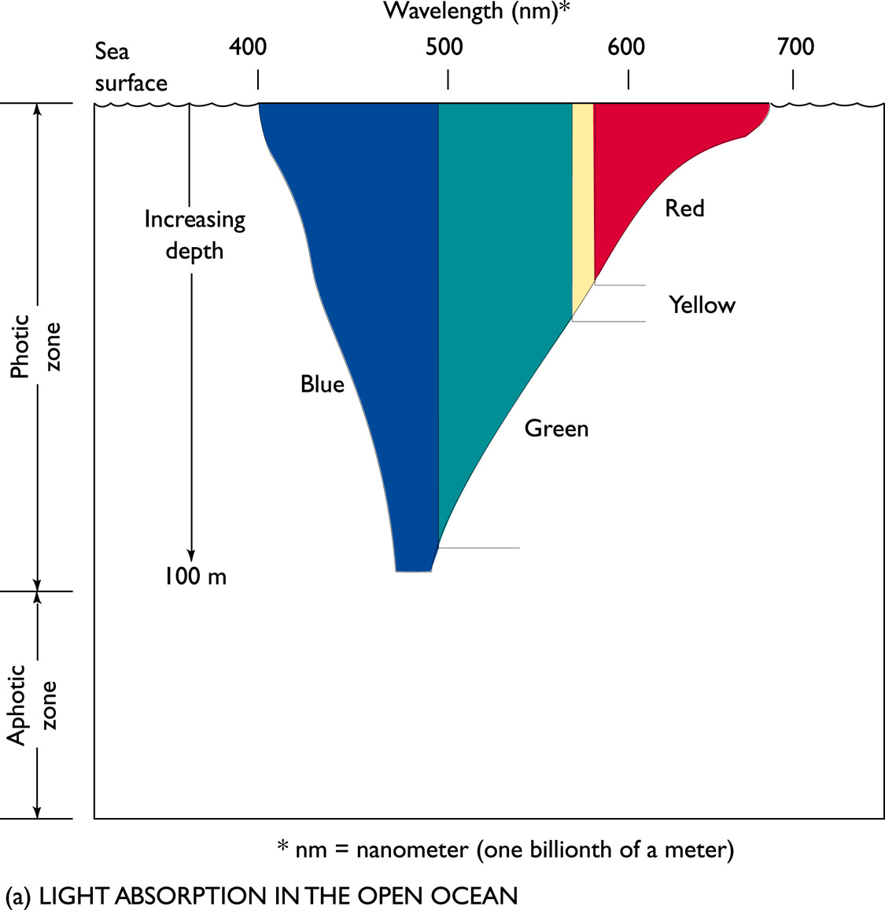

Slide 17
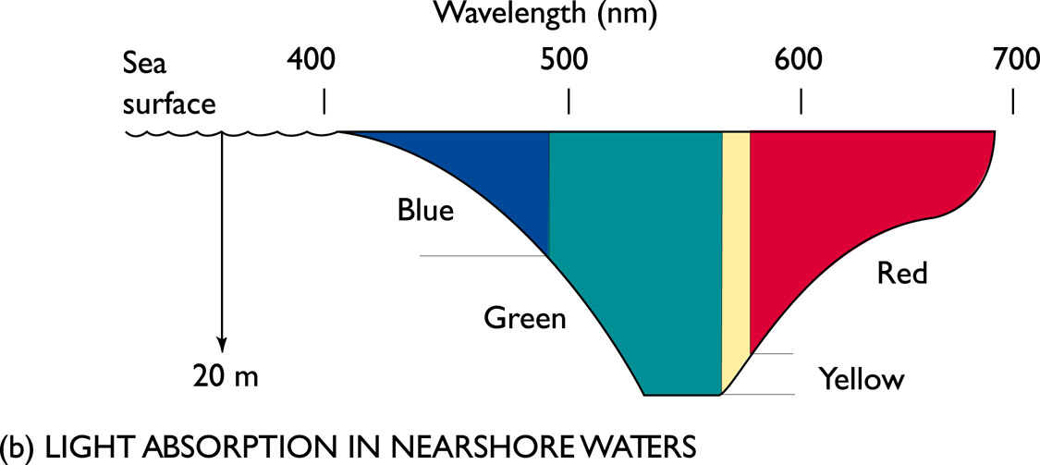

Slide 21
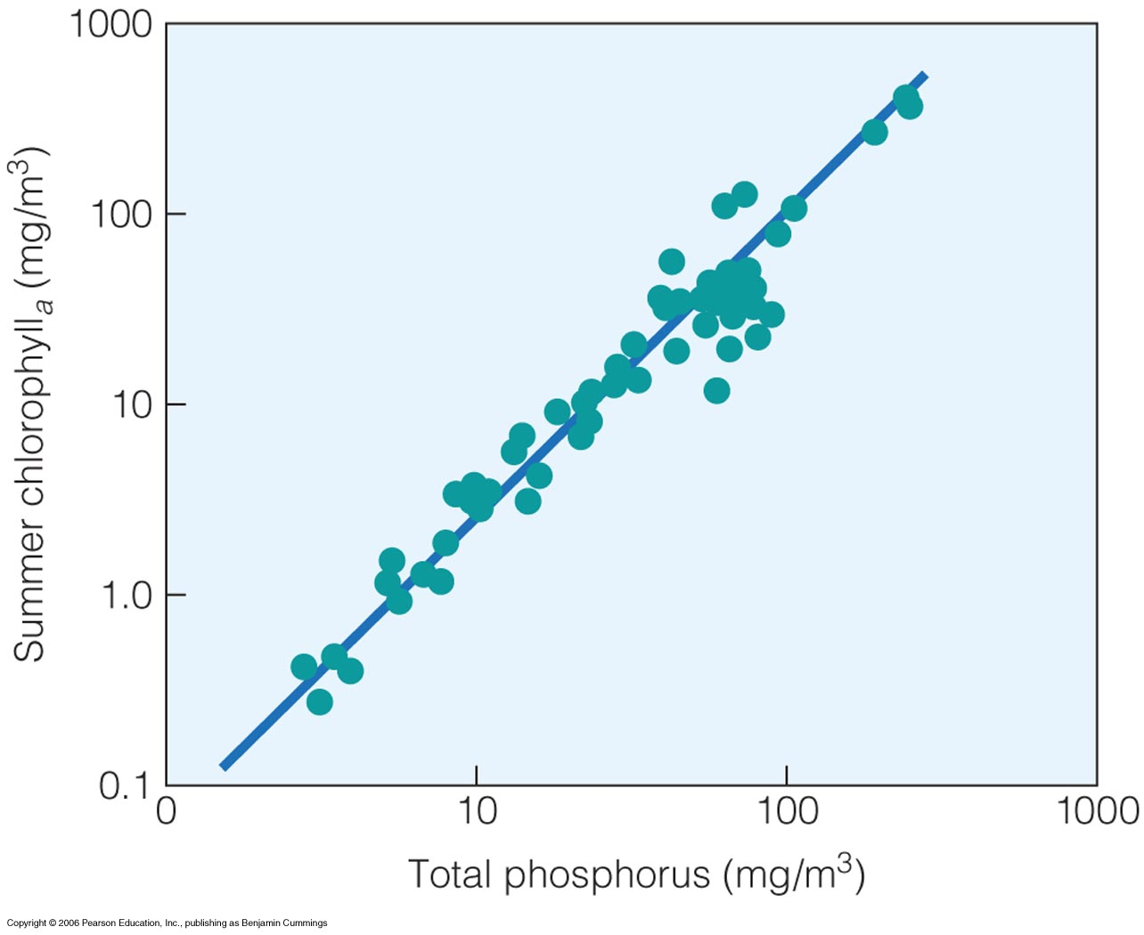
Fattori che limitano la produzione
primaria aquatica
Notes:
Figure 20.11, nutrient evailability on primary productivity; chlorophyll acts as a proxy for primary production

Slide 23
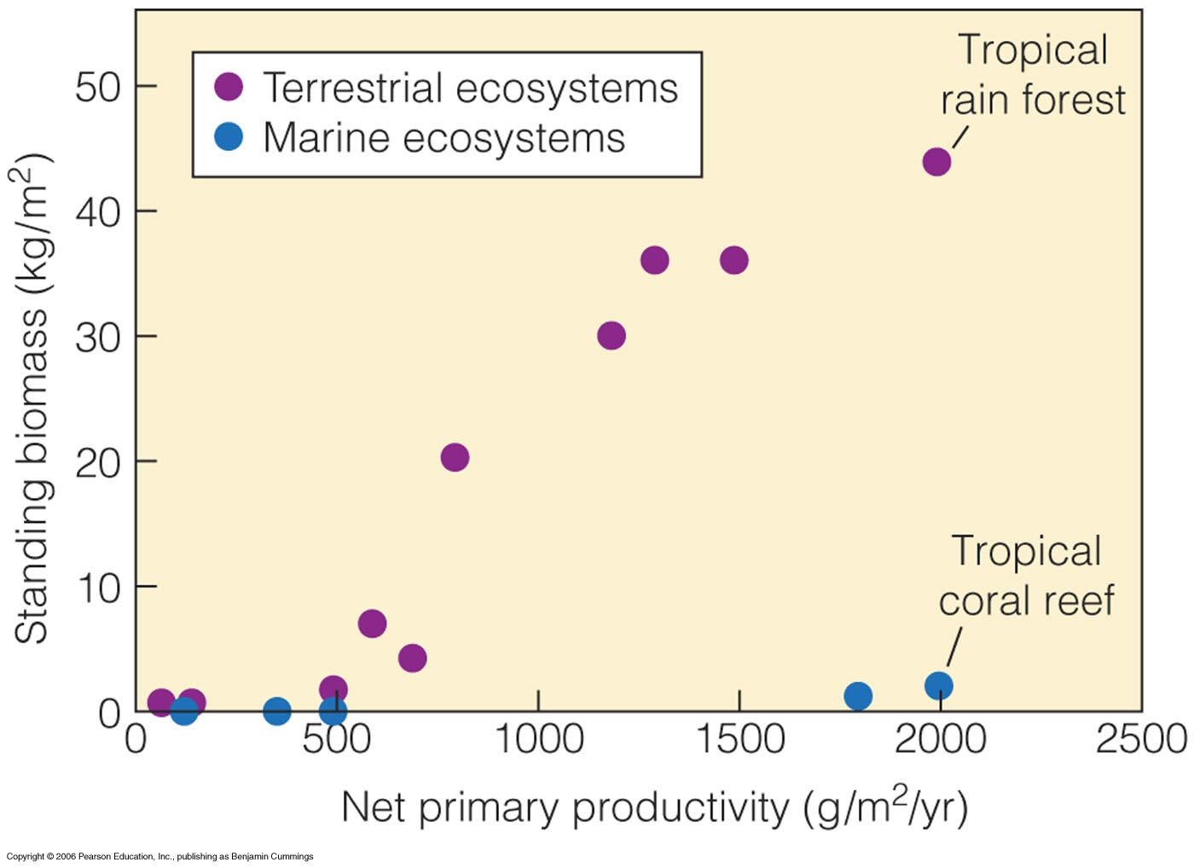
Allocazione dell’energia
Notes:
Figure 20.12

Slide 24
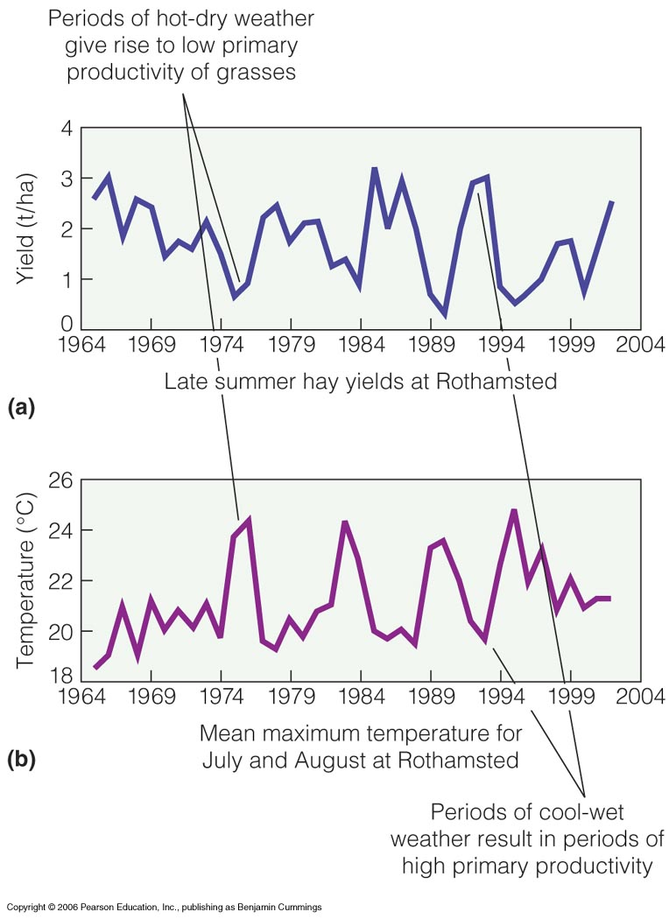
La produzione primaria varia con il tempo
Notes:
Figure 20.13
Primary production varies with time and age
Yields depressed in hot, dry summers

Slide 25
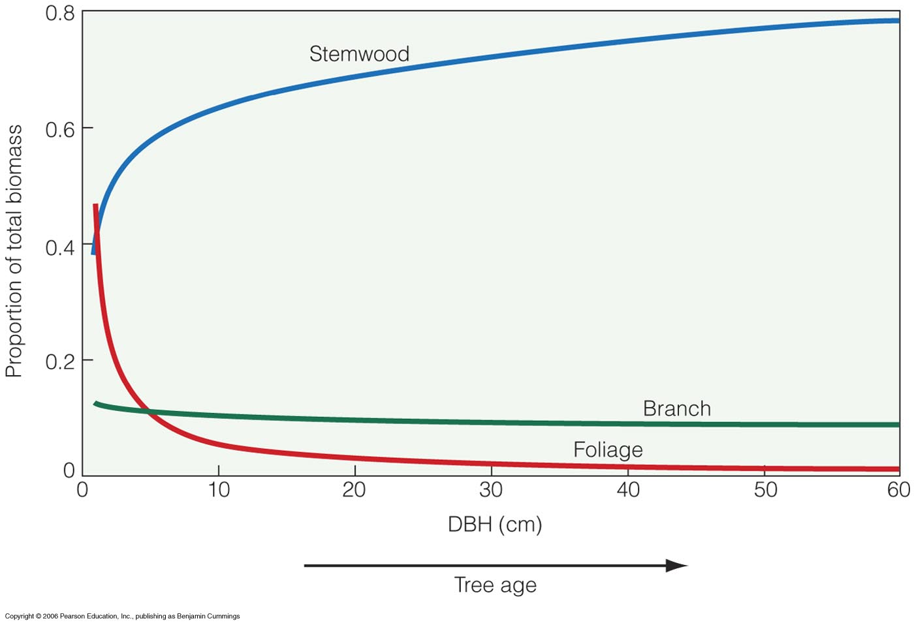
La produzione primaria varia con il tempo
Notes:
Figure 20.14
Proportion of biomass, at first, lot more goes into leaves (1/2 of biomass), then it decreases. (1-5%)

Slide 26
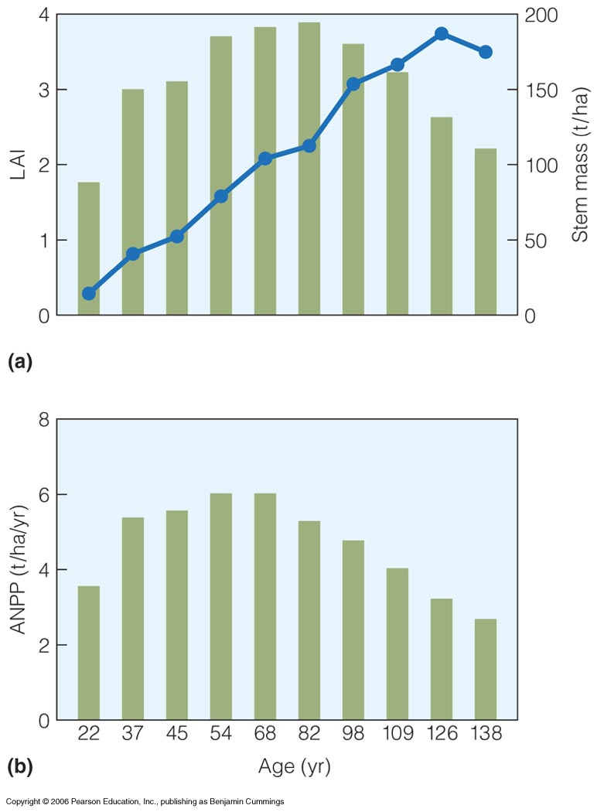
La produzione primaria varia con il tempo
Notes:
Figure 20.15
Stith Gower at U of Wisconsin - with age more of biomass is in woody tissue
As stand ages both photosynthesis and respiration decline

Slide 27
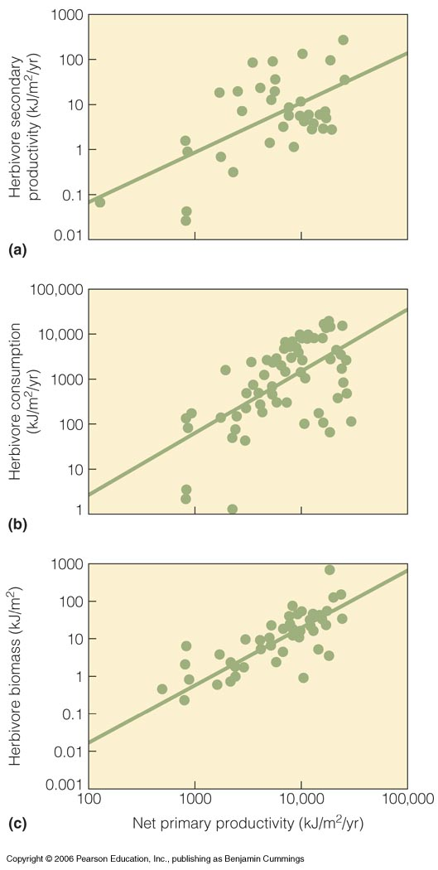
La produzione primaria limita quella secondaria
Notes:
Figure 20.16
Net production is the energy available to the heterotrophic component of the ecosystem (either herbivores or decomposers eventually consume all plant prodiction.
Secondary productivity is greatest when the bithrate of the population and the grwoth rate of individuals are highest
Compiled by Sam mcNaughton, Syracuse U 69 studies

Slide 28
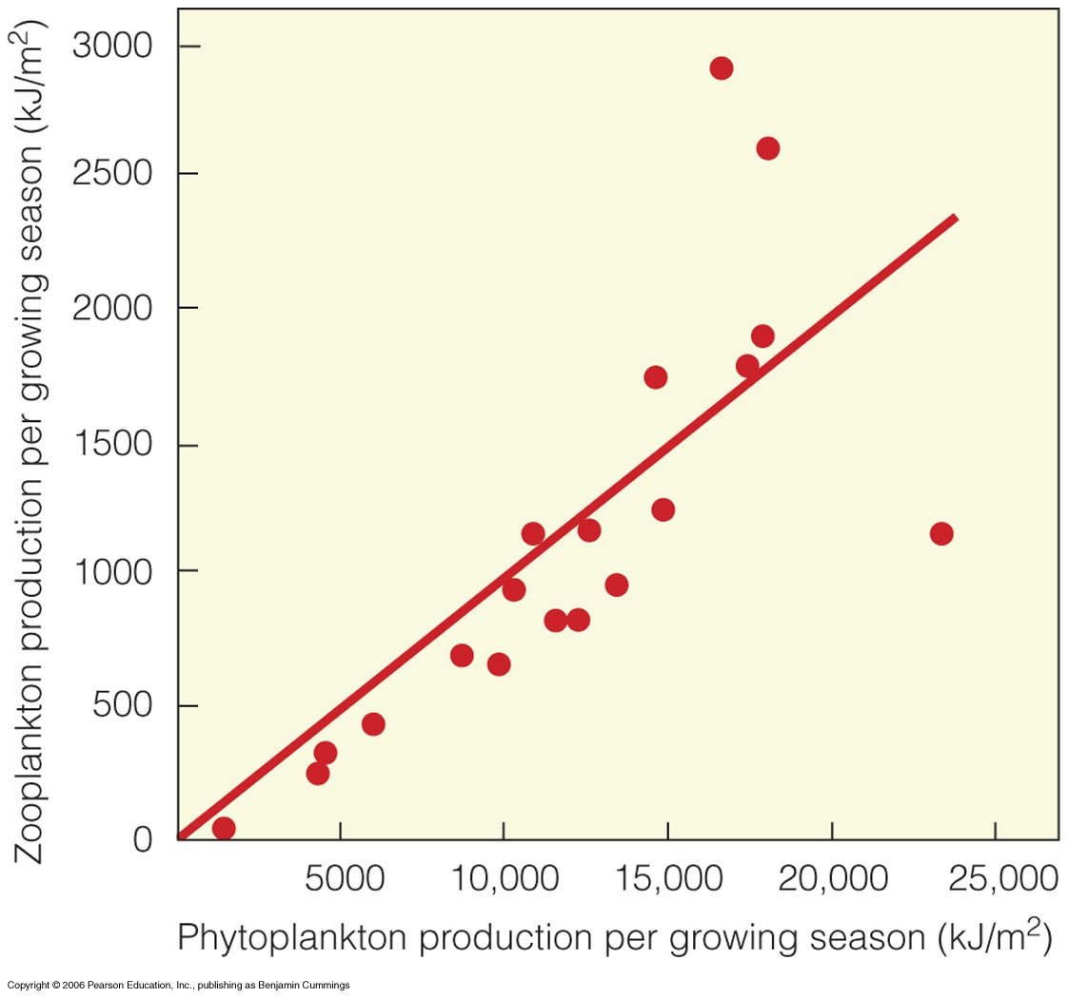
La produzione primaria limita quella secondaria
Notes:
Figure 20.17
Brylinsky and Mann of Dalhoisue 43 lakes and 12 reservoirs (tropics to Arctic) : significant positive relationship
These figures suggest a bottom-up control on the flow of energy through ecosystems, although in many ecosystems there are important top-down controls

Slide 39
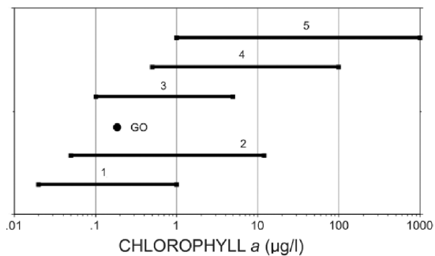
HABs
Nord-Atlantico
Estuari e acque costiere
Media oceani (0.19)
Corrente della California
Mar dei Sargassi, Caraibi, Pacifico equatoriale

Slide 43
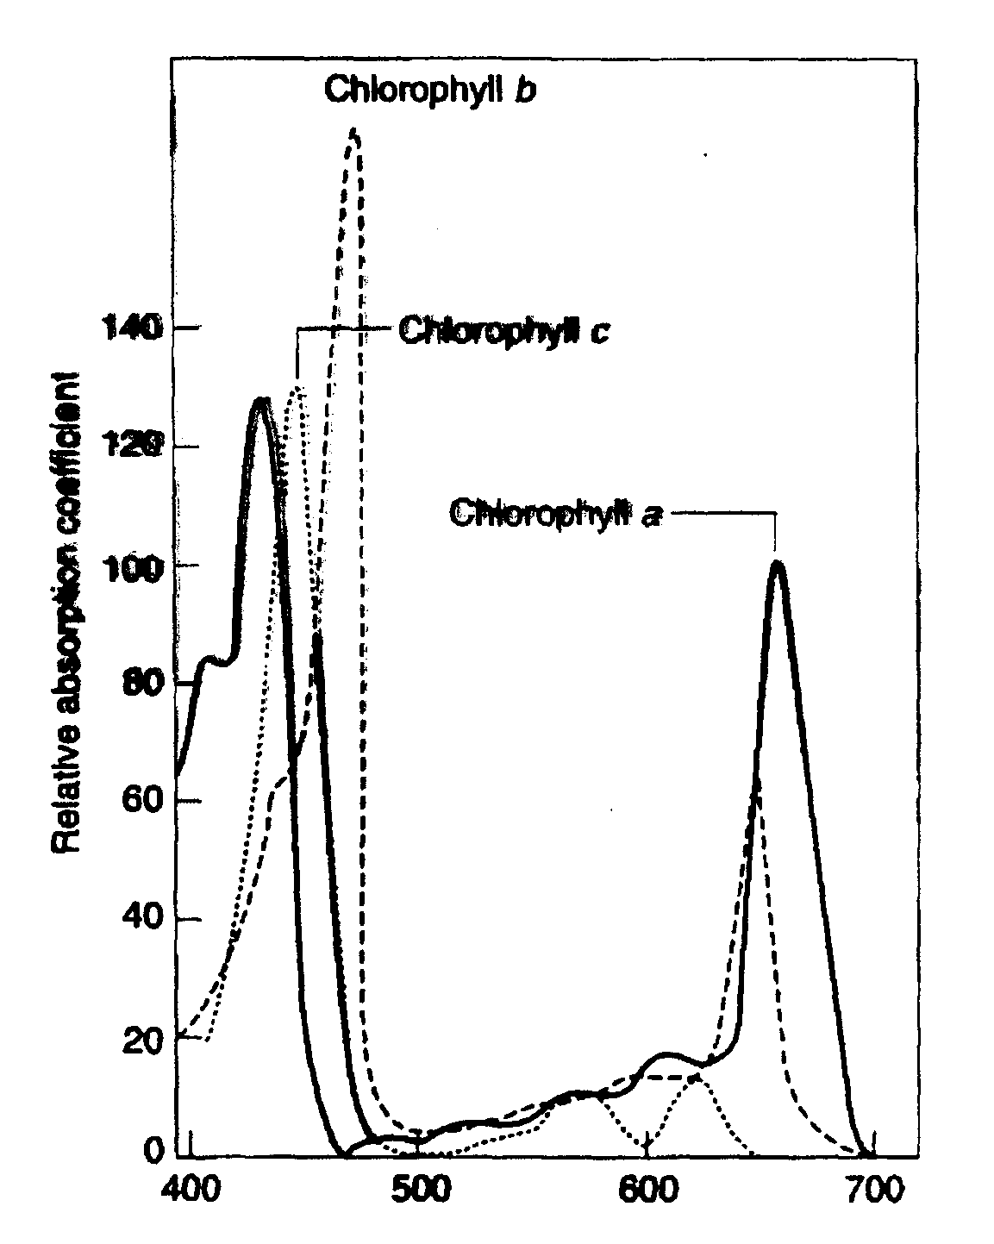

Slide 44
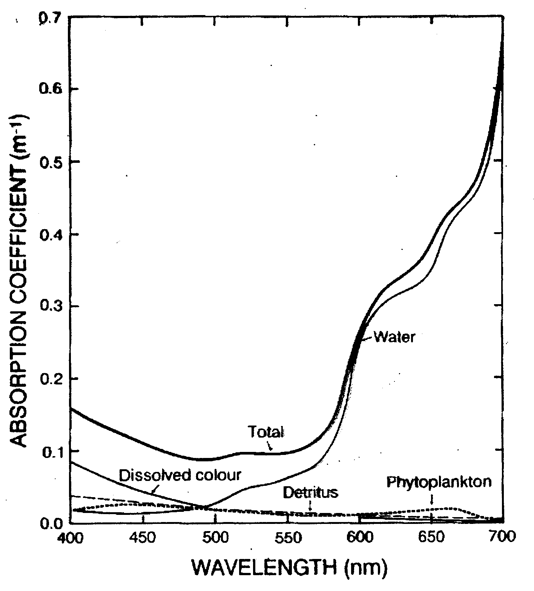

Slide 46
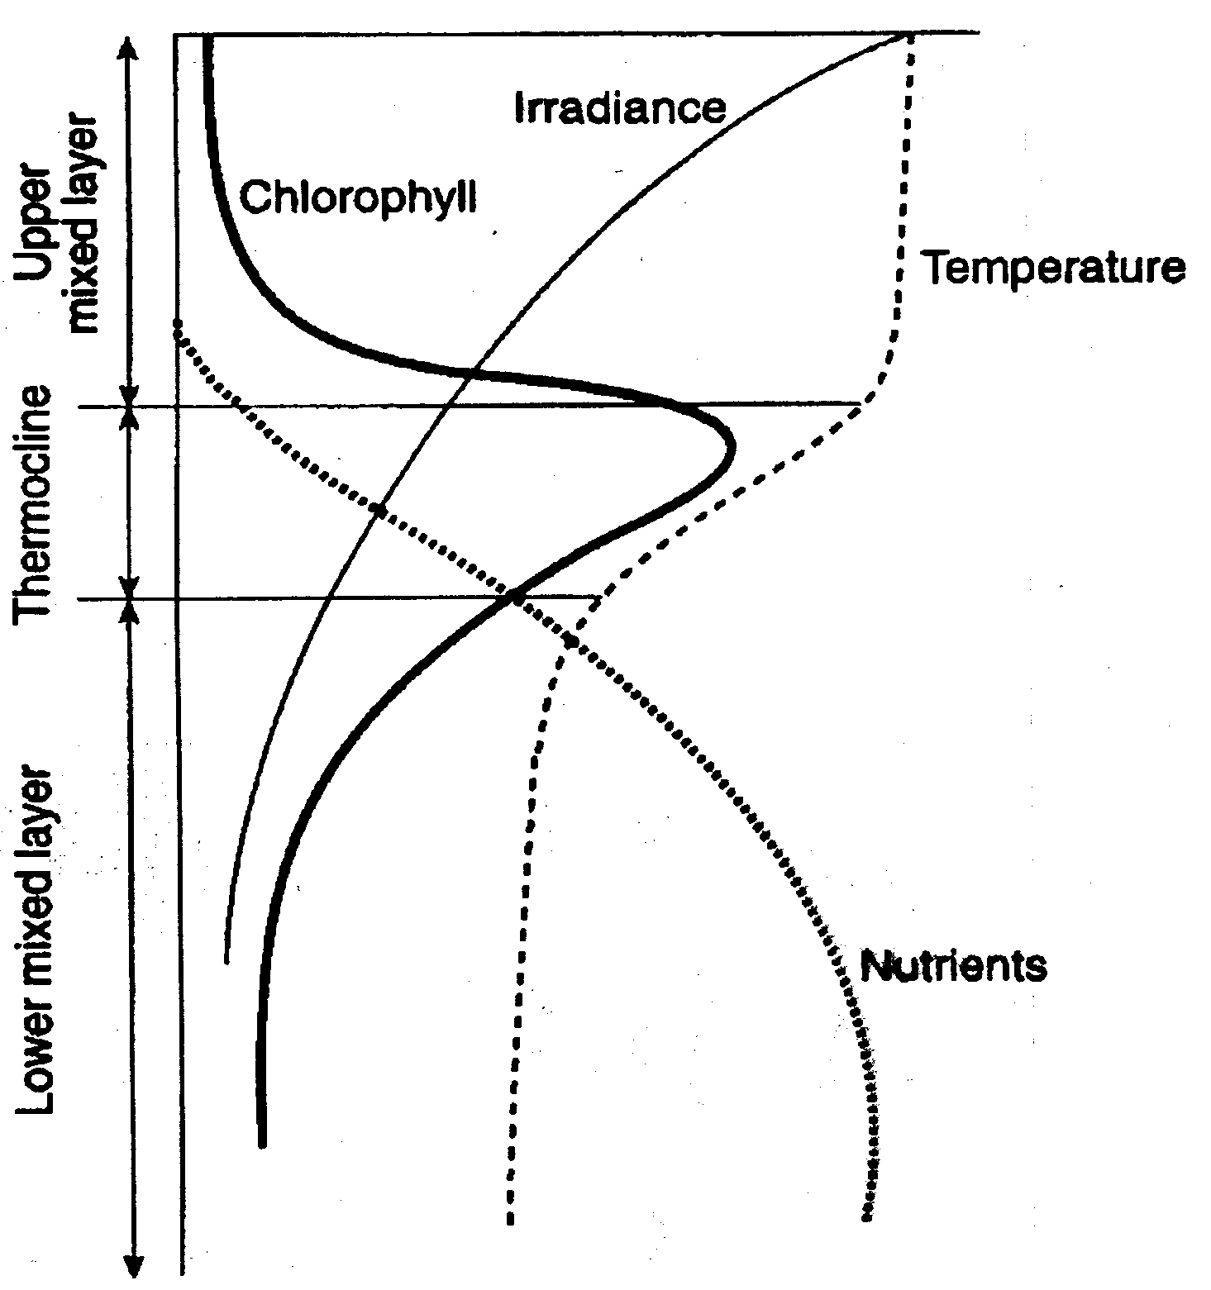

Slide 48
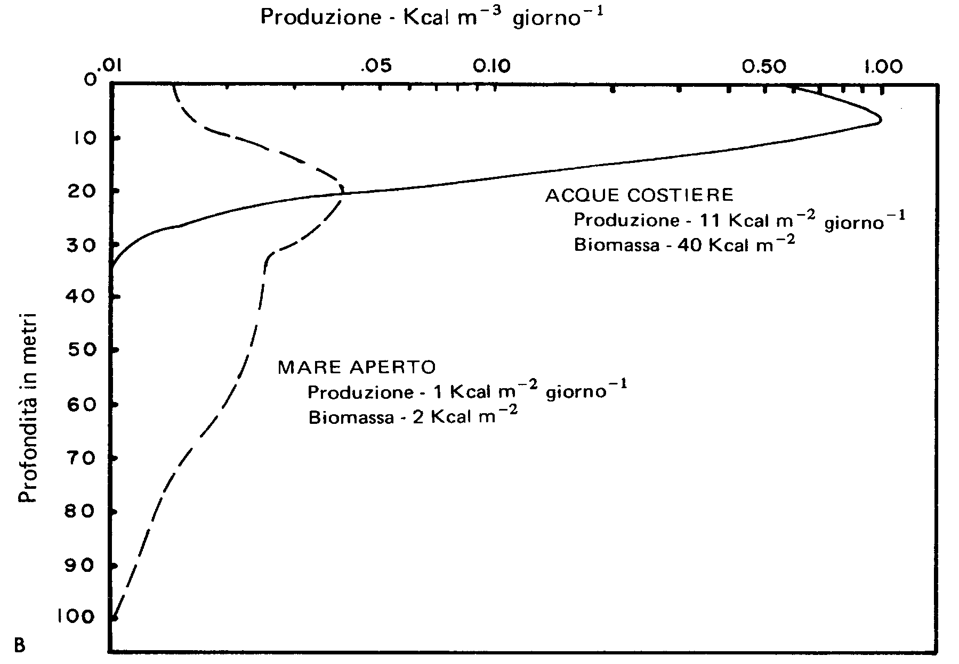

Slide 49
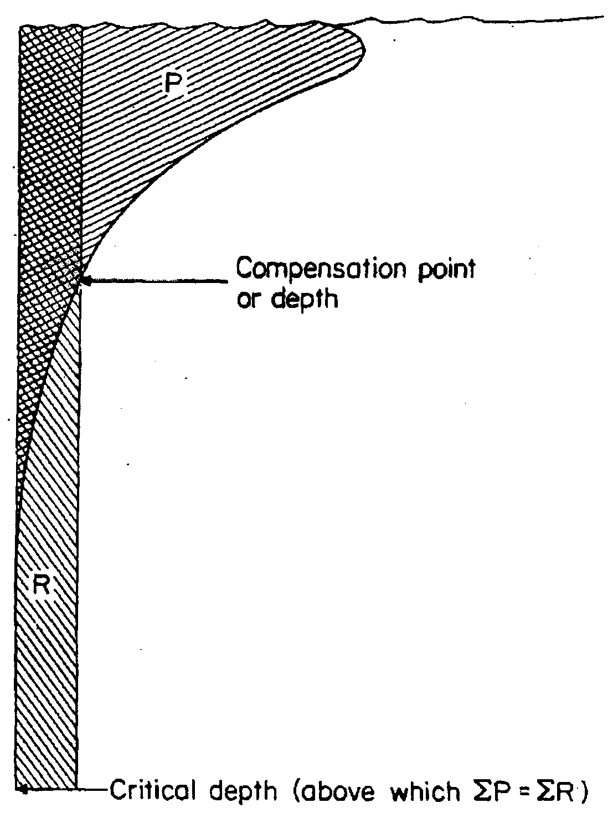

Slide 54
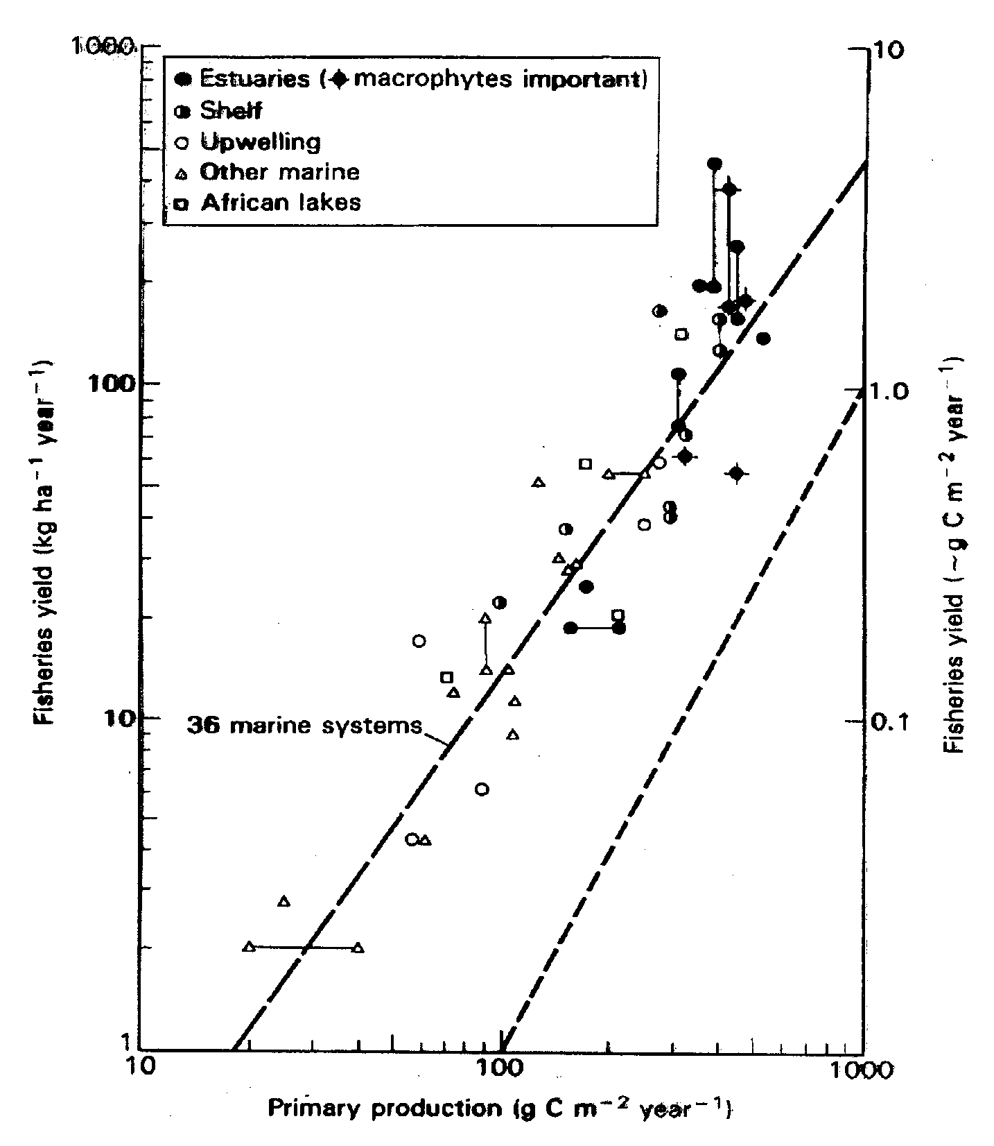
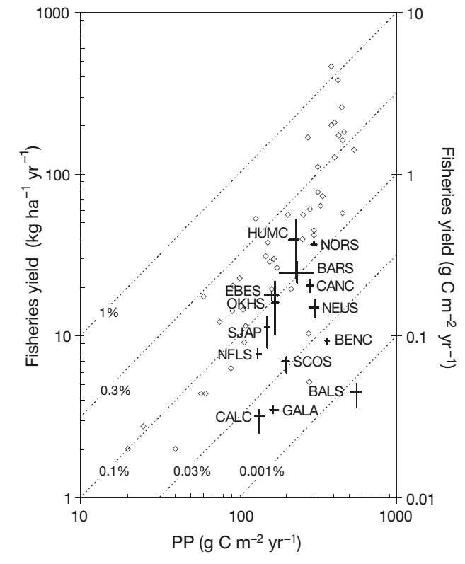
(Nixon, 1982, 1992; Nixon et al., 1986)
(Conti & Scardi, 2010)

Slide 55
Ore 9:00
Ore 15:00
O₂=8.5
mg m⁻³
O₂=8.2
mg m⁻³
O₂=8.2
mg m⁻³
O₂=8.0
mg m⁻³
Bottiglia chiara:
ΔO₂ = O₂(15:00) - O₂(9:00) = 8.5 - 8.2 = 0.3 mg m⁻³
Bottiglia scura:
ΔO₂ = O₂(15:00) - O₂(9:00) = 8.0 - 8.2 = - 0.2 mg m⁻³

Slide 56
Ore 9:00
Ore 15:00
O₂=8.5
mg m⁻³
➔
0.3 mg m⁻³
P_{L}
O₂=8.2
mg m⁻³
O₂=8.2
mg m⁻³
0.2 mg m⁻³
➔
P ➔
O₂=8.0
mg m⁻³
R ➔
P_{N} ∝ =
ΔO₂
0.3 mg m⁻³
R ∝ =
ΔO₂
0.2 mg m⁻³
P_{L} = (P_{N} + R) ∝ ( + )
P_{L} ∝
0.2 mg m⁻³
0.3 mg m⁻³
0.2 mg m⁻³
0.3 mg m⁻³
P_{L} ∝ 0.3 + 0.2 = 0.5 mg O₂ m⁻³
P_{L} ora⁻¹ ∝ (0.3 + 0.2)/6 = 0.083 mg O₂ m⁻³ ora⁻¹

Slide 57
P_{L} ora⁻¹ ∝ (0.3 + 0.2)/6 = 0.083 mg O₂ m⁻³ ora⁻¹
6CO₂ + 6H₂O ➔ C₆H₁₂O₆ + 6O₂
C ➔ 12 g / mole
fissando 6 x 12 g C
si liberano 6 x 2 x 16 g O
O ➔ 16 g / mole
72 g C
192 g O
= 0.375
1 mg O₂ m⁻³ ora⁻¹ = 0.375 mg C m⁻³ ora⁻¹
P_{L} = 0.083 mg O₂ m⁻³ ora⁻¹ x 0.375 = 0.031 mg C m⁻³ ora⁻¹
P_{L} = 0.031 mg C m⁻³ ora⁻¹

